Slide 1
Opinion Mining
Ayan Karim

Slide 2


Business Problem
Any company that sells a product in mass production generates a huge amount of public opinion on the product and tons of reviews, articles, reactions and overall sentiments are posted online, especially soon after release.
As of 2017, 223 million iPhones were sold in the US, which is huge considering the population was 325 million (this information was from 2017)!
How do companies access this data from the public media and turn it into something useful? How do we extract all that diverse information from the web and analyze it??

Slide 3
Introduction
What is Opinion Mining?
What is Aspect-Based Sentiment Analysis

Slide 4
Let’s Pretend We’re Apple!
What does Public Opinion tell us about the iPhone X?
What do people dislike about the iPhone X?
How does our product compare with that of a competing smartphone like the Samsung Galaxy S9?

Slide 5
Pipeline
1. Scrape text data from the web
2. Process our texts
3. Latent Dirichlet Allocation to extract and assign topics
4. ML classifiers trained on text data to classify Topics
5. Model text to Extract Sentiments and Aspects
6. Assign aspects and sentiments to topics
7. Matplotlib and Seaborn to Visualize results

Slide 6
Technology
1. Scrapy to scrape data
2. NLTK, Spacy and Gensim process texts
3. Gensim's Latent Dirichlet Allocation, Countvectorizer and TF-IDF vectorizer to extract and assign topics
4. pyLDAvis for visualization
5. Scikit Learn, Multi-Label Naive Bayes and Support Vector Machines to train text data on Topics
6. Scikit Multilearn, PowerLabelset to train on multiple labels
7. Spacy for Aspect-Based Semantic Analysis
8. Word2Vec pre-trained on Google's News dataset for assigning aspects and sentiments to topics
9. Matplotlib and Seaborn for data visualization

Slide 7
Pre-trained and Other Datasets
1. Opinion Lexicon by Minqinq Hu and Bing Liu
2. Word2Vec pre-trained on Google's News dataset for assigning aspects and sentiments to topics
3. WordSim353 to Evaluate Word2Vec model

Slide 8



Part 1: Topic Modeling

Slide 9
digitaltrends.com gizmodo.com techradar.com
1. iPhone X
2. Galaxy S9
3. Pixel 3
4. Huawei Mate 20 Pro
5. OnePlus 6T
6. Huawei P2 Pro
7. LG V4 Thinq
8. Sony Xperia XZ3
9. Essential Phone
10. Razer Phone 2
11. HTC U12+
12. Moto G6 plus

Slide 10
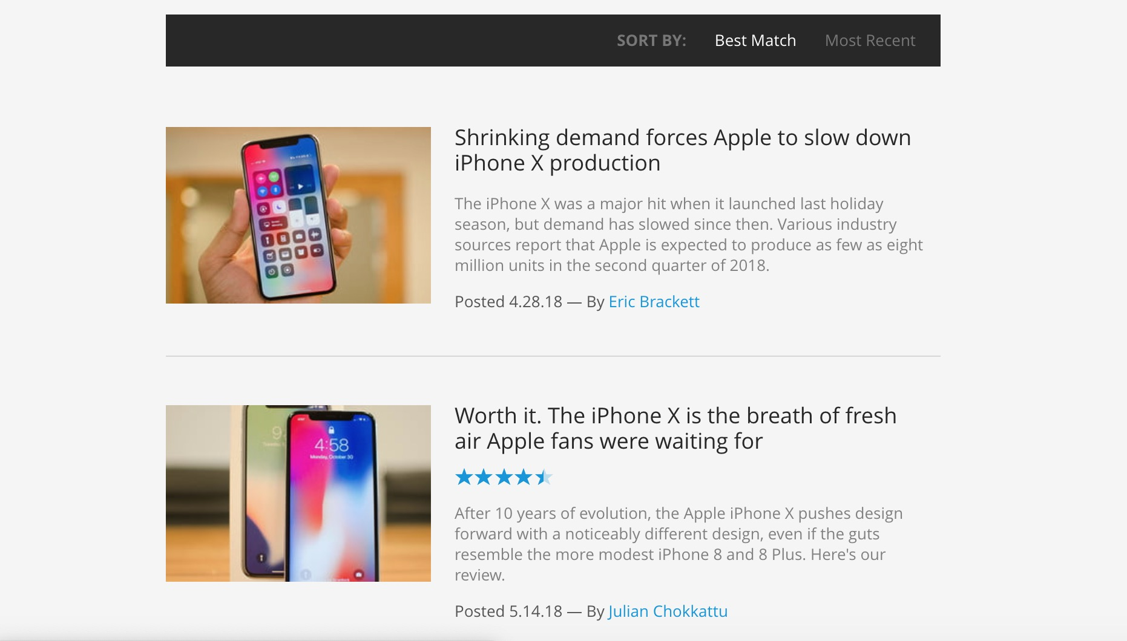

Slide 11
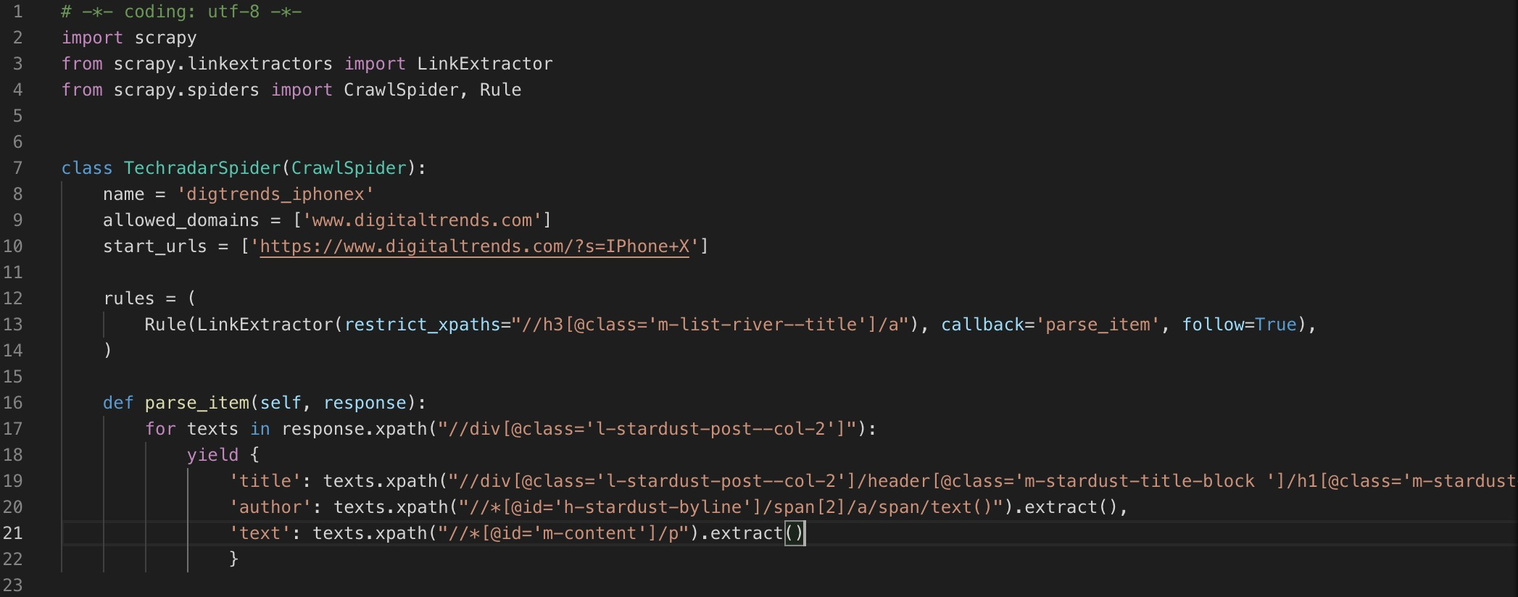

Slide 12
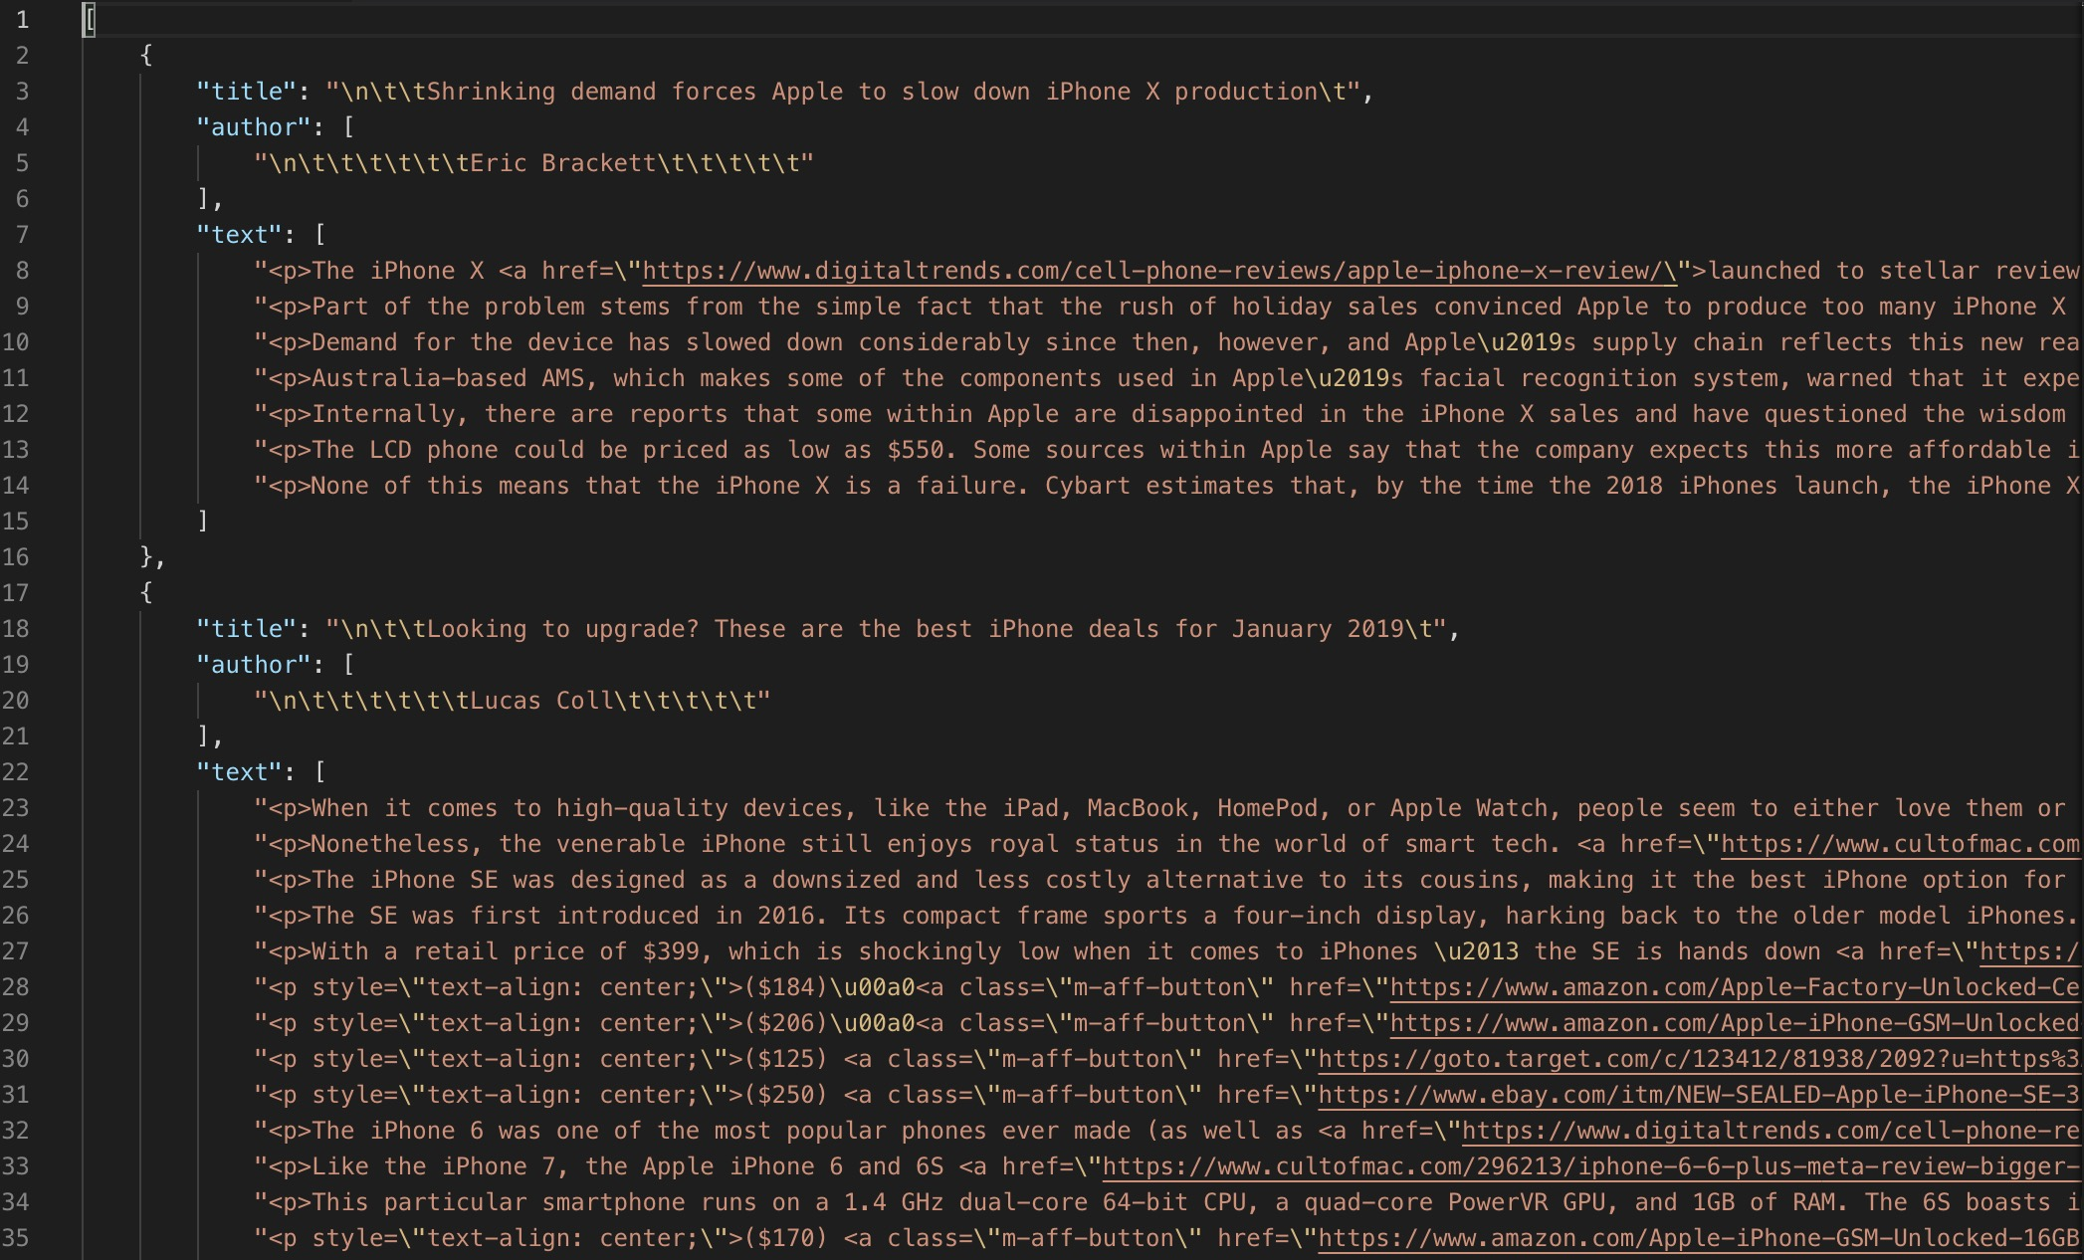

Slide 13
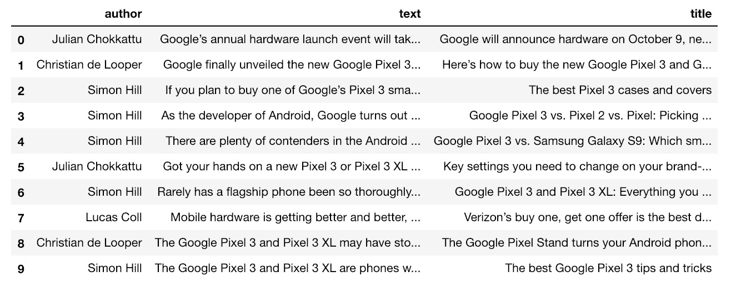

Slide 14
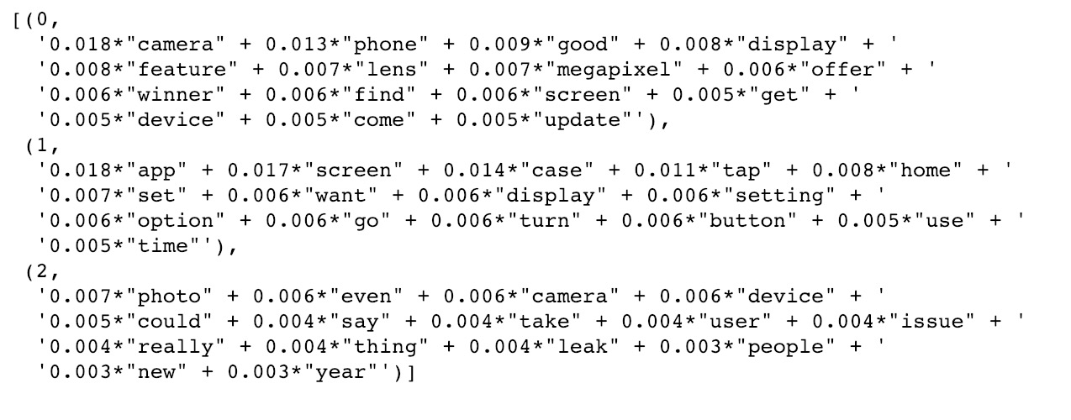
Latent Dirichlet Allocation

Slide 15
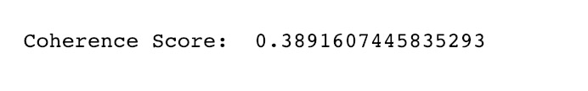
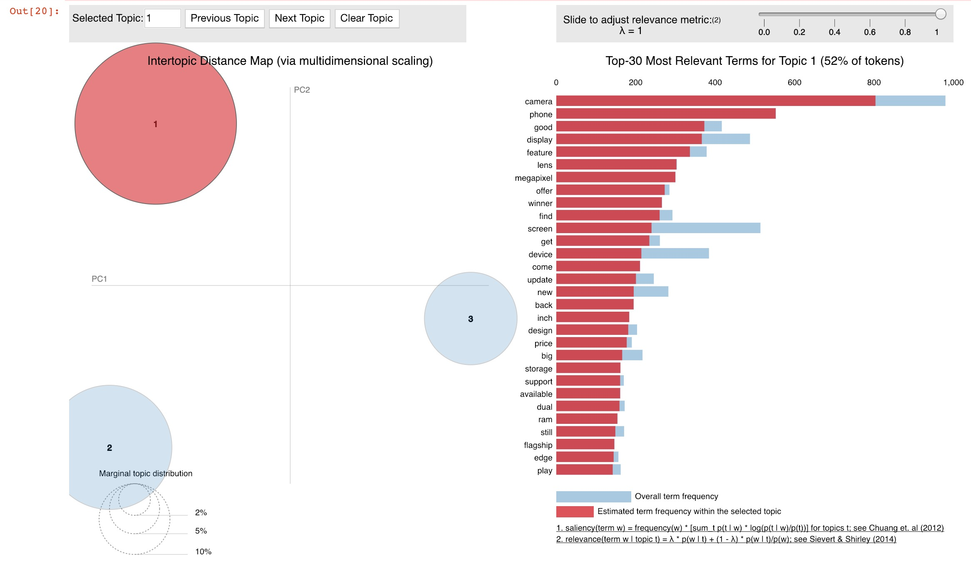
Coherence and pyLDAvis

Slide 16
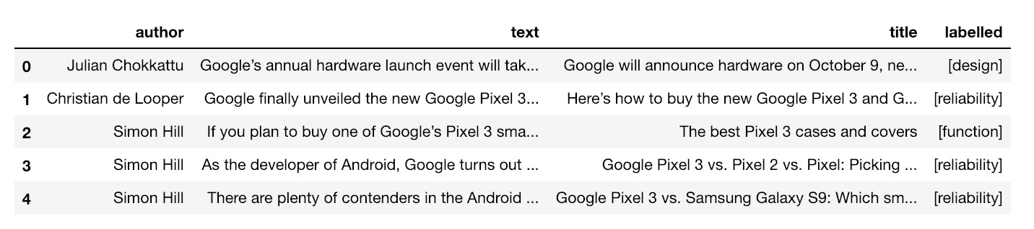
Assign Labels

Slide 17
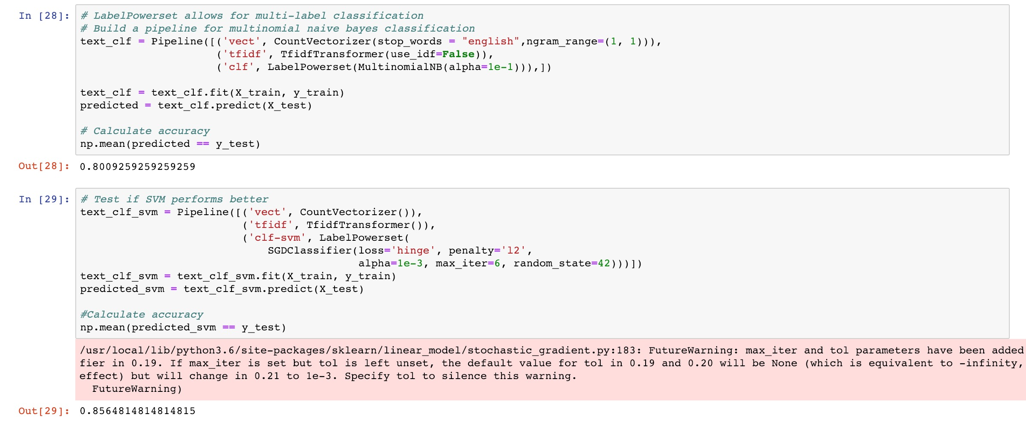
Multi-Label Classifier

Slide 18
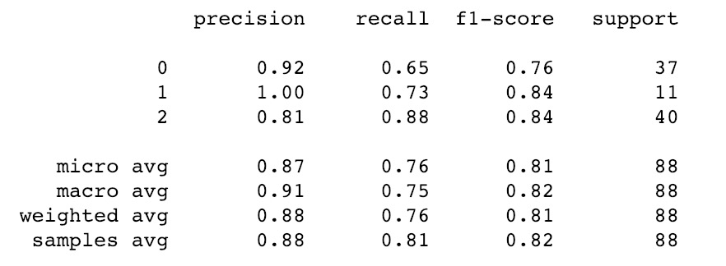
SVM Multi-Label Classifier

Slide 19
Part 2: Aspect-Based Sentiment Analysis

Slide 20
digitaltrends.com gizmodo.com techradar.com
1. iPhone X
2. Galaxy S9

Slide 21
Aspect-Based Sent. Analysis Pipeline
Extract
Extract Aspect and Sentiment.
“The screen is ugly”
“The apps are smooth”
Score and Classify
Score Terms and Sentiments then Classify them into Topics.
{Design: {“screen”: -1}, Function: {“buttons”: 1}}
Visualize
Visualize Topics, Aspects and Sentiments.

Slide 22
Extract Aspect and Sentiment
Pseudo Code:
For token in each sentence:
Check if the token is in the Opinions Lexicon
Assign a +1 if it’s a positive term or -1 if it’s a negative term
Add more weight to tokens with adjectives (1.5 for pos, -1.5 for neg)
Check if negation on a sentiment term
Switch the sign of the score
Check for nouns
Assign sentiment scores to nouns

Slide 23
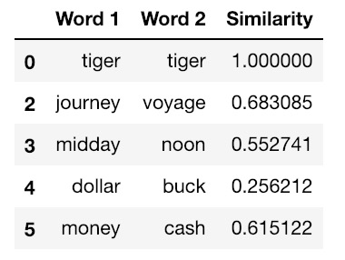
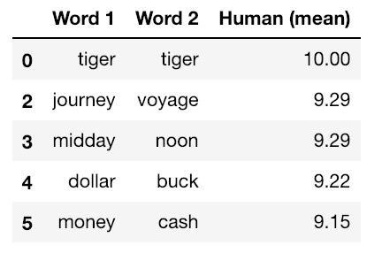

Evaluating Word2Vec using WordSim353 Data Base

Slide 24
Classify Aspect, Sentiment into Topics
Pseudo Code:
For term in sentiment dictionary:
If similarity between term and topic using Word2Vec Model is higher than a certain threshold
Assign term, sentiment to topic (can be assigned to more than one topic)
Otherwise, use the predicted labels from SVM
Assign term, sentiment to topic (can be assigned to more than one topic)

Slide 25
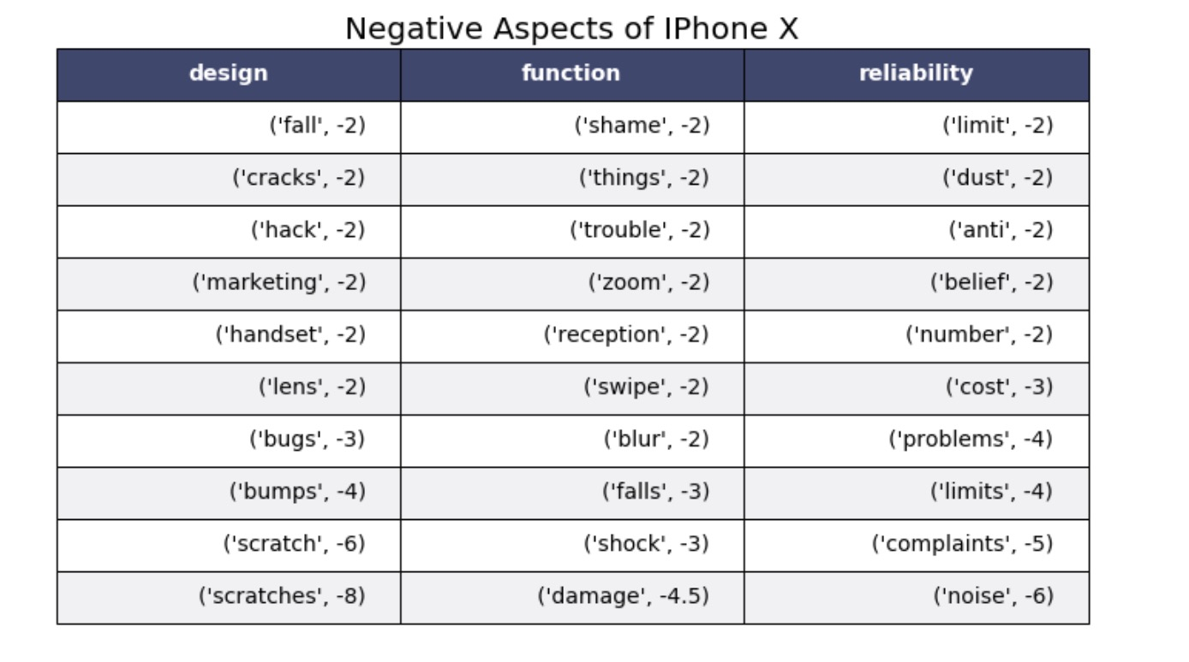
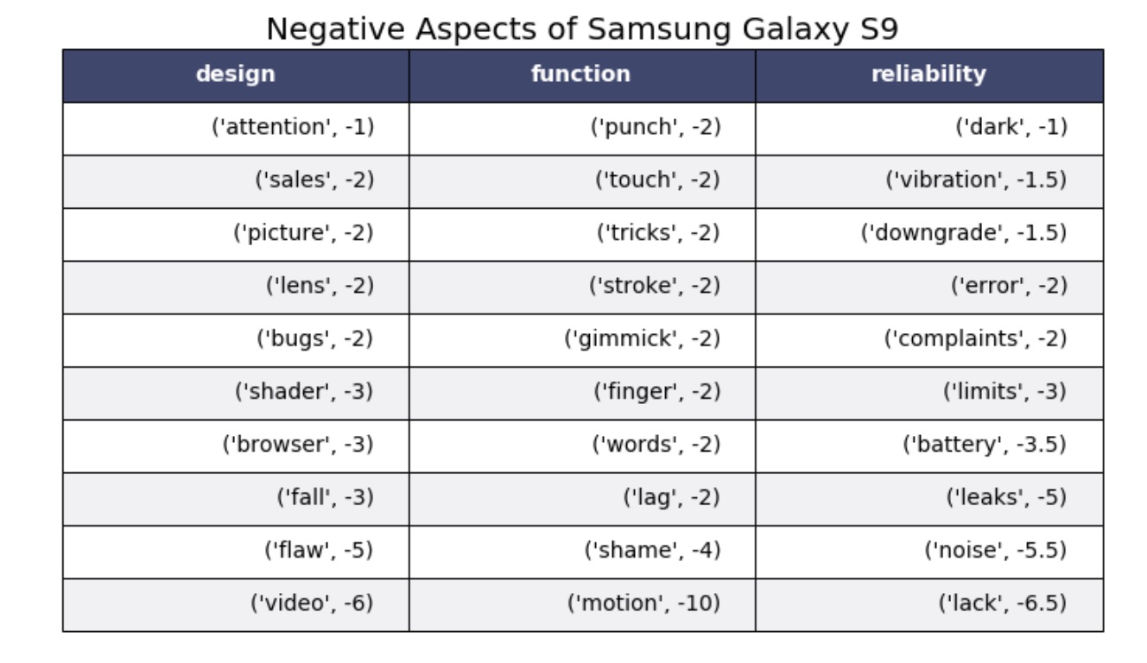
Visualize Topics, Aspects and Sentiments.

Slide 26
Analyzing Results
"scratch", "scratches", "bumps", "damage", "shock", "falls" and "cracks" are shown as the most negative aspects of design and function, almost in sequence. iPhone X has a problem with its durability.
Samsung S9 has a more diverse set of problems from "video", "lag" to "motion" and "battery”.

Slide 27
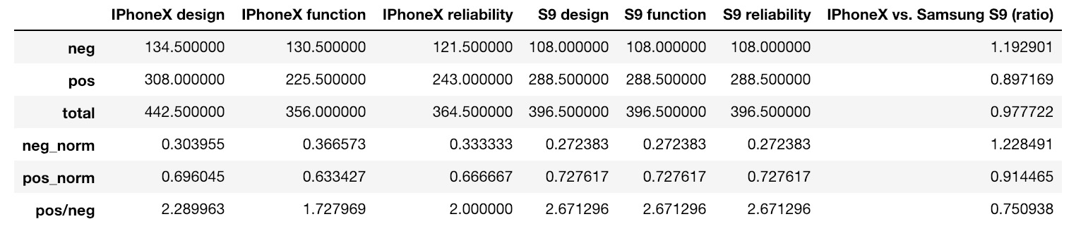
iPhone X vs. Samsung Galaxy S9

Slide 28
Analyze Comparison Ratios Between Phones
There's a higher ratio of negative sentiments for iPhone X (1.193) and a lower ratio of positive sentiments (0.897).
The same trend is seen for the ratio of sentiments after normalizing for total amount of sentiments (neg_norm: 1.229 and pos_norm: 0.91)

Slide 29
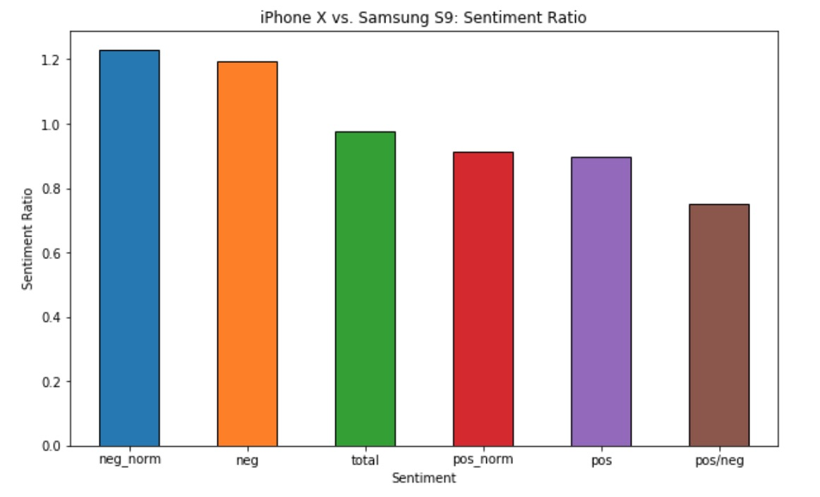
iPhone X vs. Samsung Galaxy S9

Slide 30
Conclusions

Slide 31
Improvements
1. We need to collect more data
2. Research into how to extended Opinion Lexicons
3. Apply methodology to to combine synonyms as the same aspect, so that there aren’t duplicate information
4. Incorporate bigrams, trigrams and other non-common words into aspects

Slide 32
Next Steps
1. Set up a feature for standardized streaming of data that updates our datasets in intervals.
2. Develop a recommendation engine to recommend which aspects should are most actionable for product development based on our results.

Slide 33
Bibliography
"Apple iPhone sales 2018." Statista. Statista. 19 Feb. 2019 <https://www.statista.com/statistics/263401/global-apple-iphone-sales-since-3rd-quarter-2007/>.
Bansal, Shivam, and Natural Language Processing and Machine Learning. "Beginners Guide to Topic Modeling in Python." Analytics Vidhya. 11 Jan. 2019. 19 Feb. 2019 <https://www.analyticsvidhya.com/blog/2016/08/beginners-guide-to-topic-modeling-in-python/>.
Li, Susan. "Topic Modeling and Latent Dirichlet Allocation (LDA) in Python." Towards Data Science. 31 May 2018. Towards Data Science. 19 Feb. 2019 <https://towardsdatascience.com/topic-modeling-and-latent-dirichlet-allocation-in-python-9bf156893c24>.
Li, Susan. "Topic Modelling in Python with NLTK and Gensim – Towards Data Science." Towards Data Science. 30 Mar. 2018. Towards Data Science. 19 Feb. 2019 <https://towardsdatascience.com/topic-modelling-in-python-with-nltk-and-gensim-4ef03213cd21>.
Min, Peter. "Aspect-Based Opinion Mining (NLP with Python) – Peter Min – Medium." Medium.com. 06 June 2018. Medium. 19 Feb. 2019 <https://medium.com/@pmin91/aspect-based-opinion-mining-nlp-with-python-a53eb4752800>.
https://www.cs.uic.edu/~liub/FBS/sentiment-analysis.html
http://www.cs.technion.ac.il/~gabr/resources/data/wordsim353/
https://www.digitaltrends.com/
https://www.gizmodo.com/
https://www.techradar.com/

